Slide 2
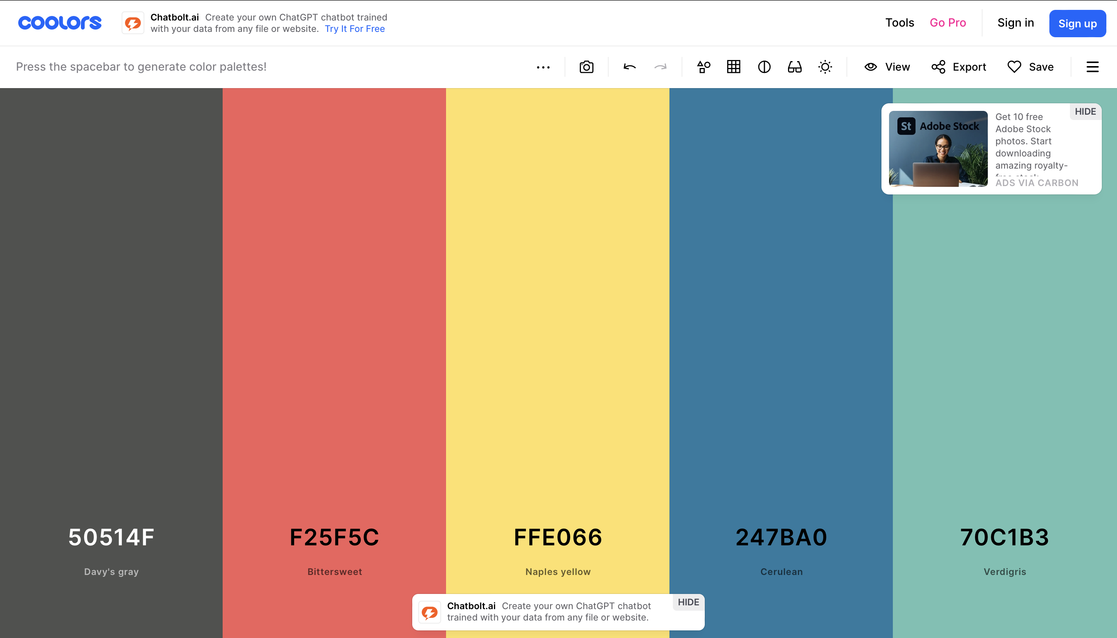
1. Color Palette Exploration
https://coolors.co/e2cfea-a06cd5-6247aa-102b3f-062726

Slide 3
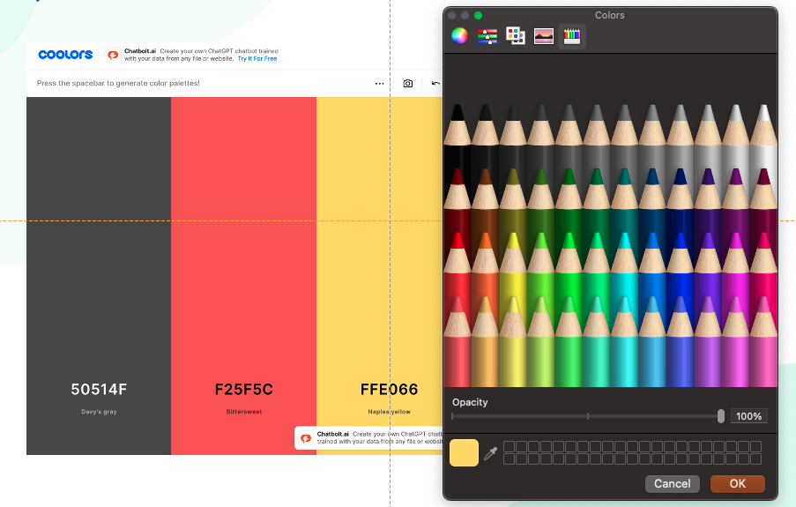
1. Color Palette Exploration
Use color picker, pick all the colors in the chosen palette.

Slide 4
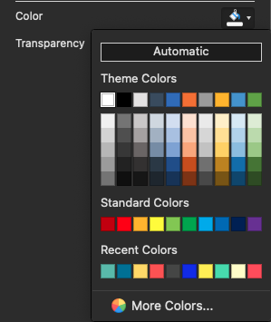
1. Color Palette Exploration
Use color picker, pick all the colors in the chosen palette.

Slide 5
2. Mastering Gradients
Use the chosen palette to add gradients.

Slide 6
2. Mastering Gradients
Use the chosen palette to add gradients.

Slide 7
3. Designing Fonts for Impact
Designing Fonts for Impact
Designing Fonts for Impact
Designing Fonts for Impact
Designing Fonts for Impact
Designing Fonts for Impact
Designing Fonts for Impact

Slide 8
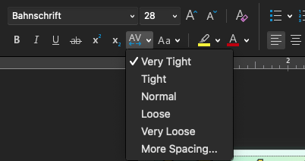
3. Designing Fonts for Impact
Designing Fonts for Impact
Designing Fonts for Impact
Designing Fonts for Impact
Designing Fonts for Impact
Designing Fonts for Impact

Slide 9
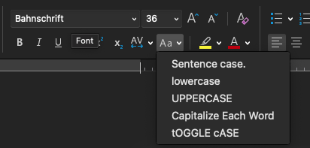
3. Designing Fonts for Impact
DESIGNING FONTS FOR IMPACT
DESIGNING FONTS FOR IMPACT
Designing Fonts for Impact
DESIGNING FONTS FOR IMPACT
DESIGNING FONTS FOR IMPACT

Slide 10
3. Designing Fonts for Impact
DESIGNING FONTS FOR IMPACT
DESIGNING FONTS FOR IMPACT
DESIGNING FONTS FOR IMPACT
DESIGNING FONTS FOR IMPACT

Slide 11
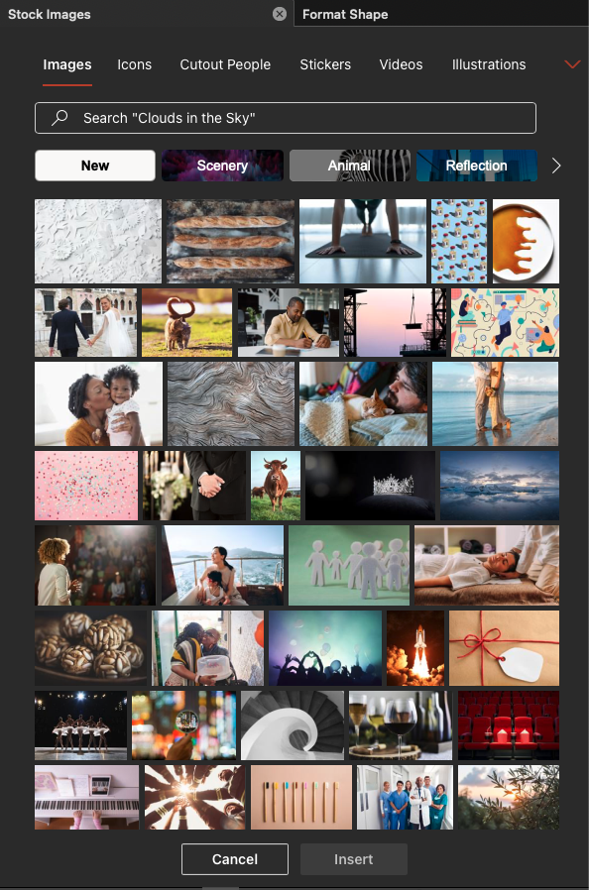
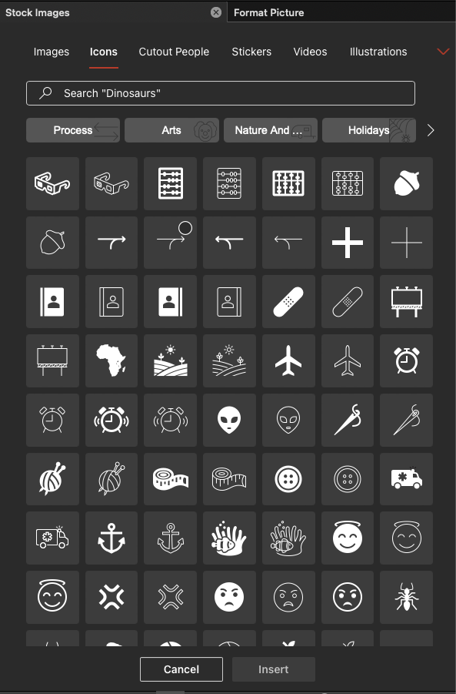
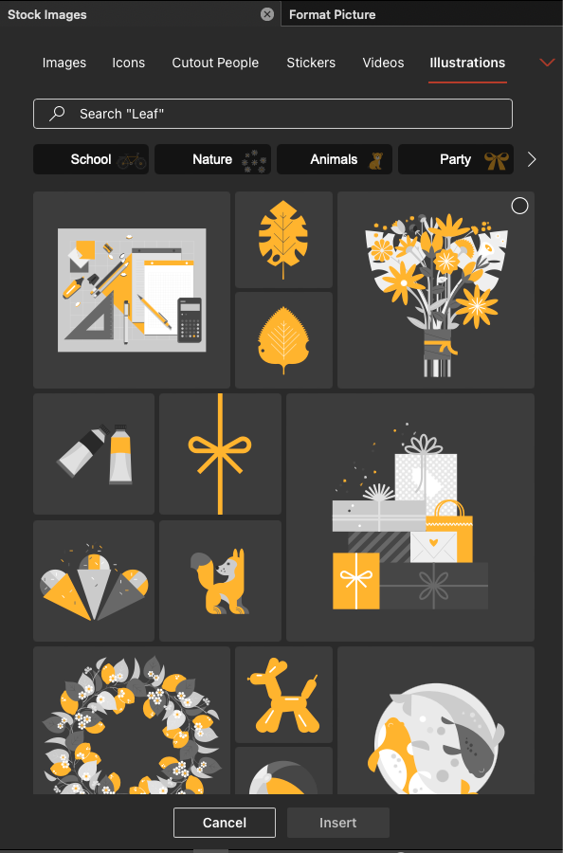
4. Sourcing Free Illustrations

Slide 12





4. Sourcing Free Illustrations

Slide 13
4. Sourcing Free Illustrations

Slide 14
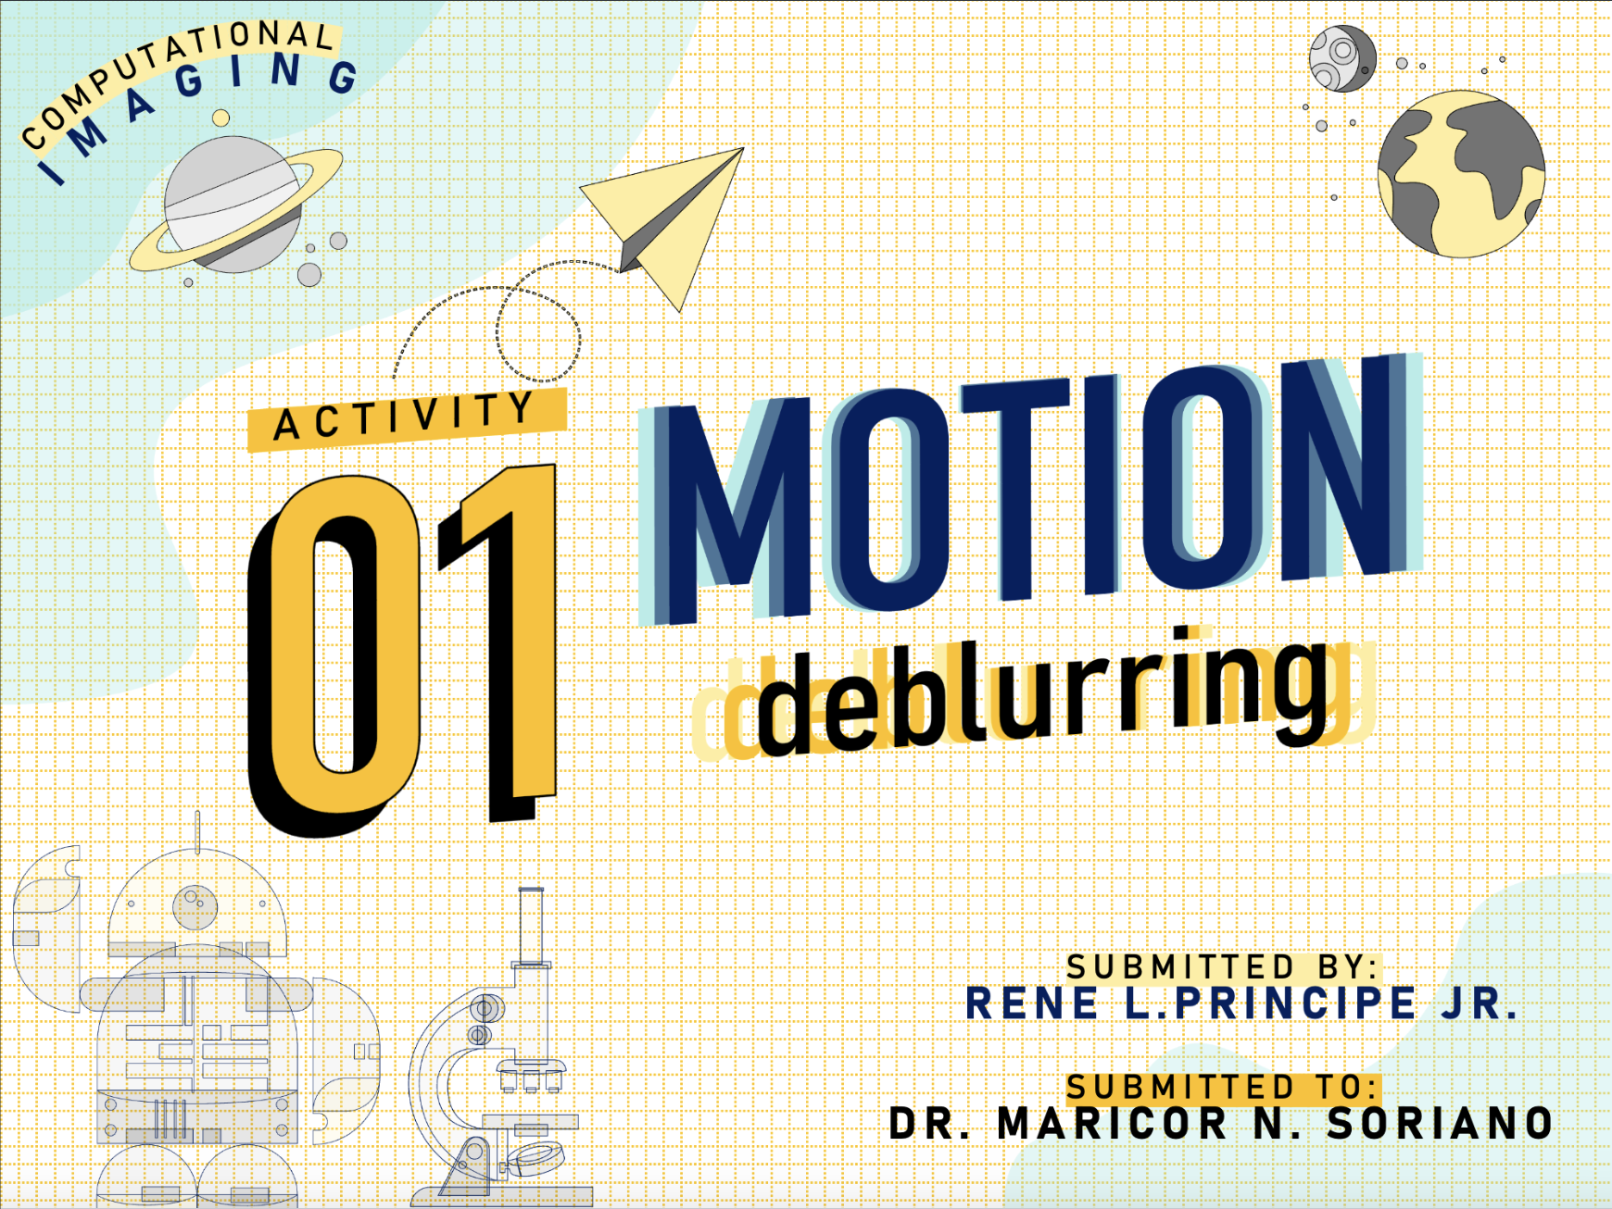

Slide 15
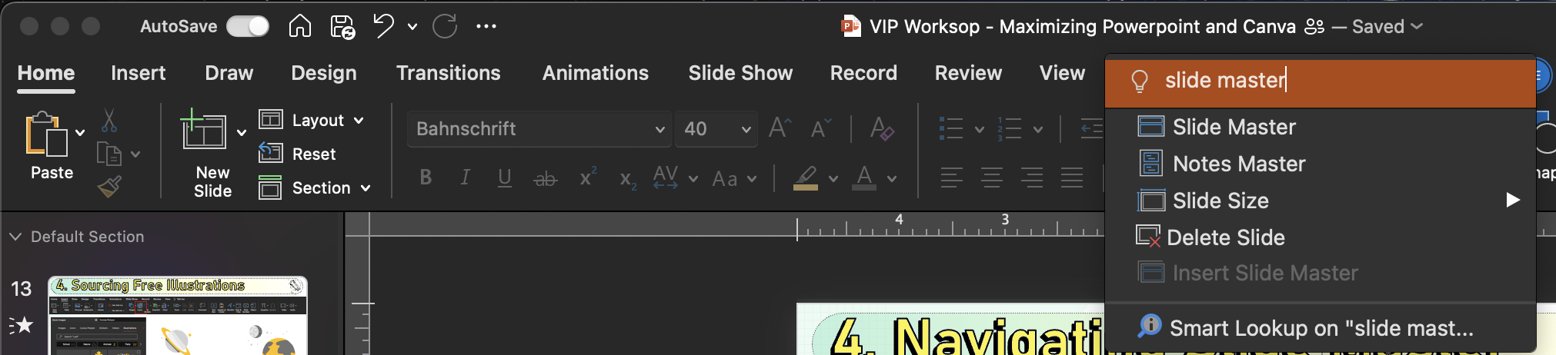
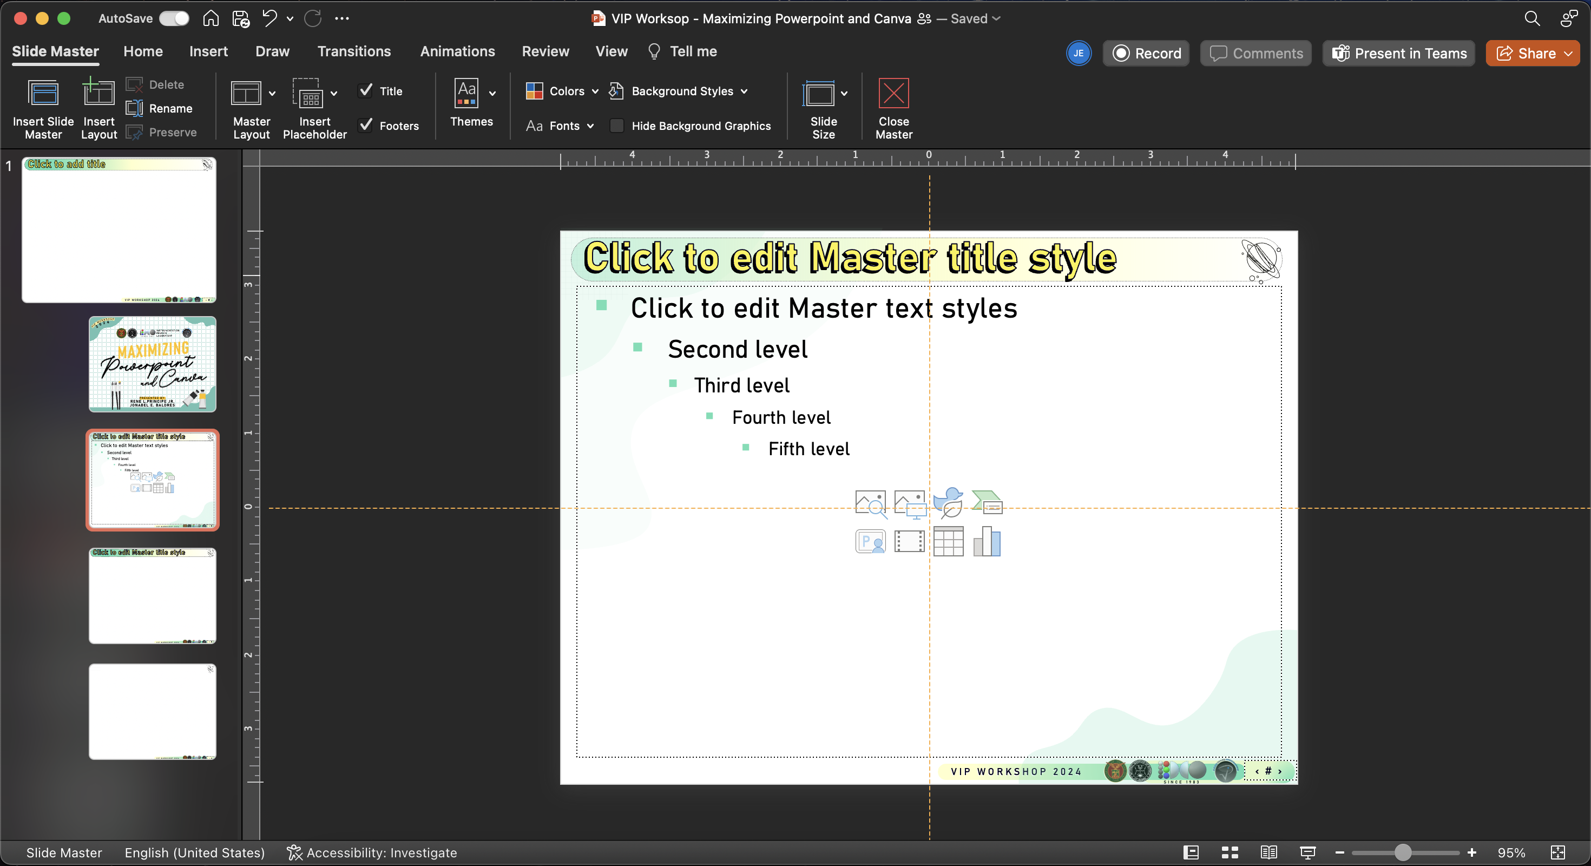
5. Navigating Slide Master

Slide 16



5. Navigating Slide Master

Slide 17
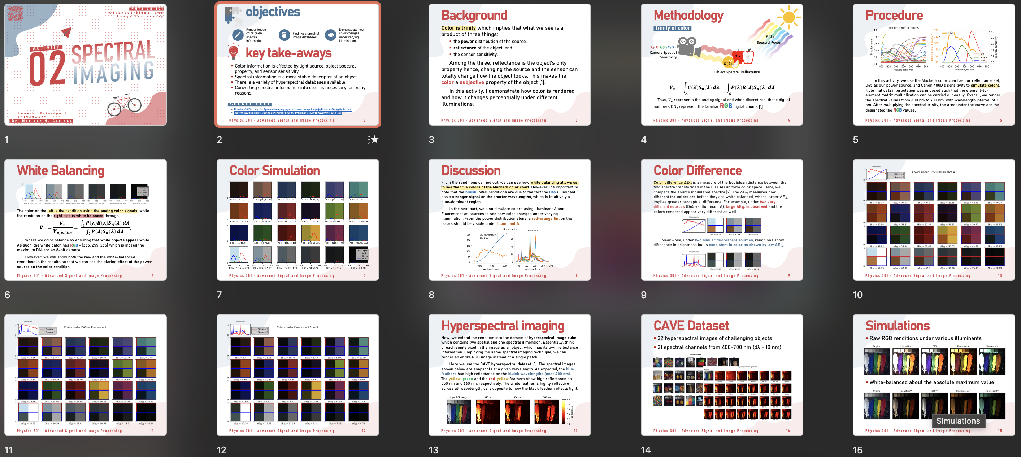
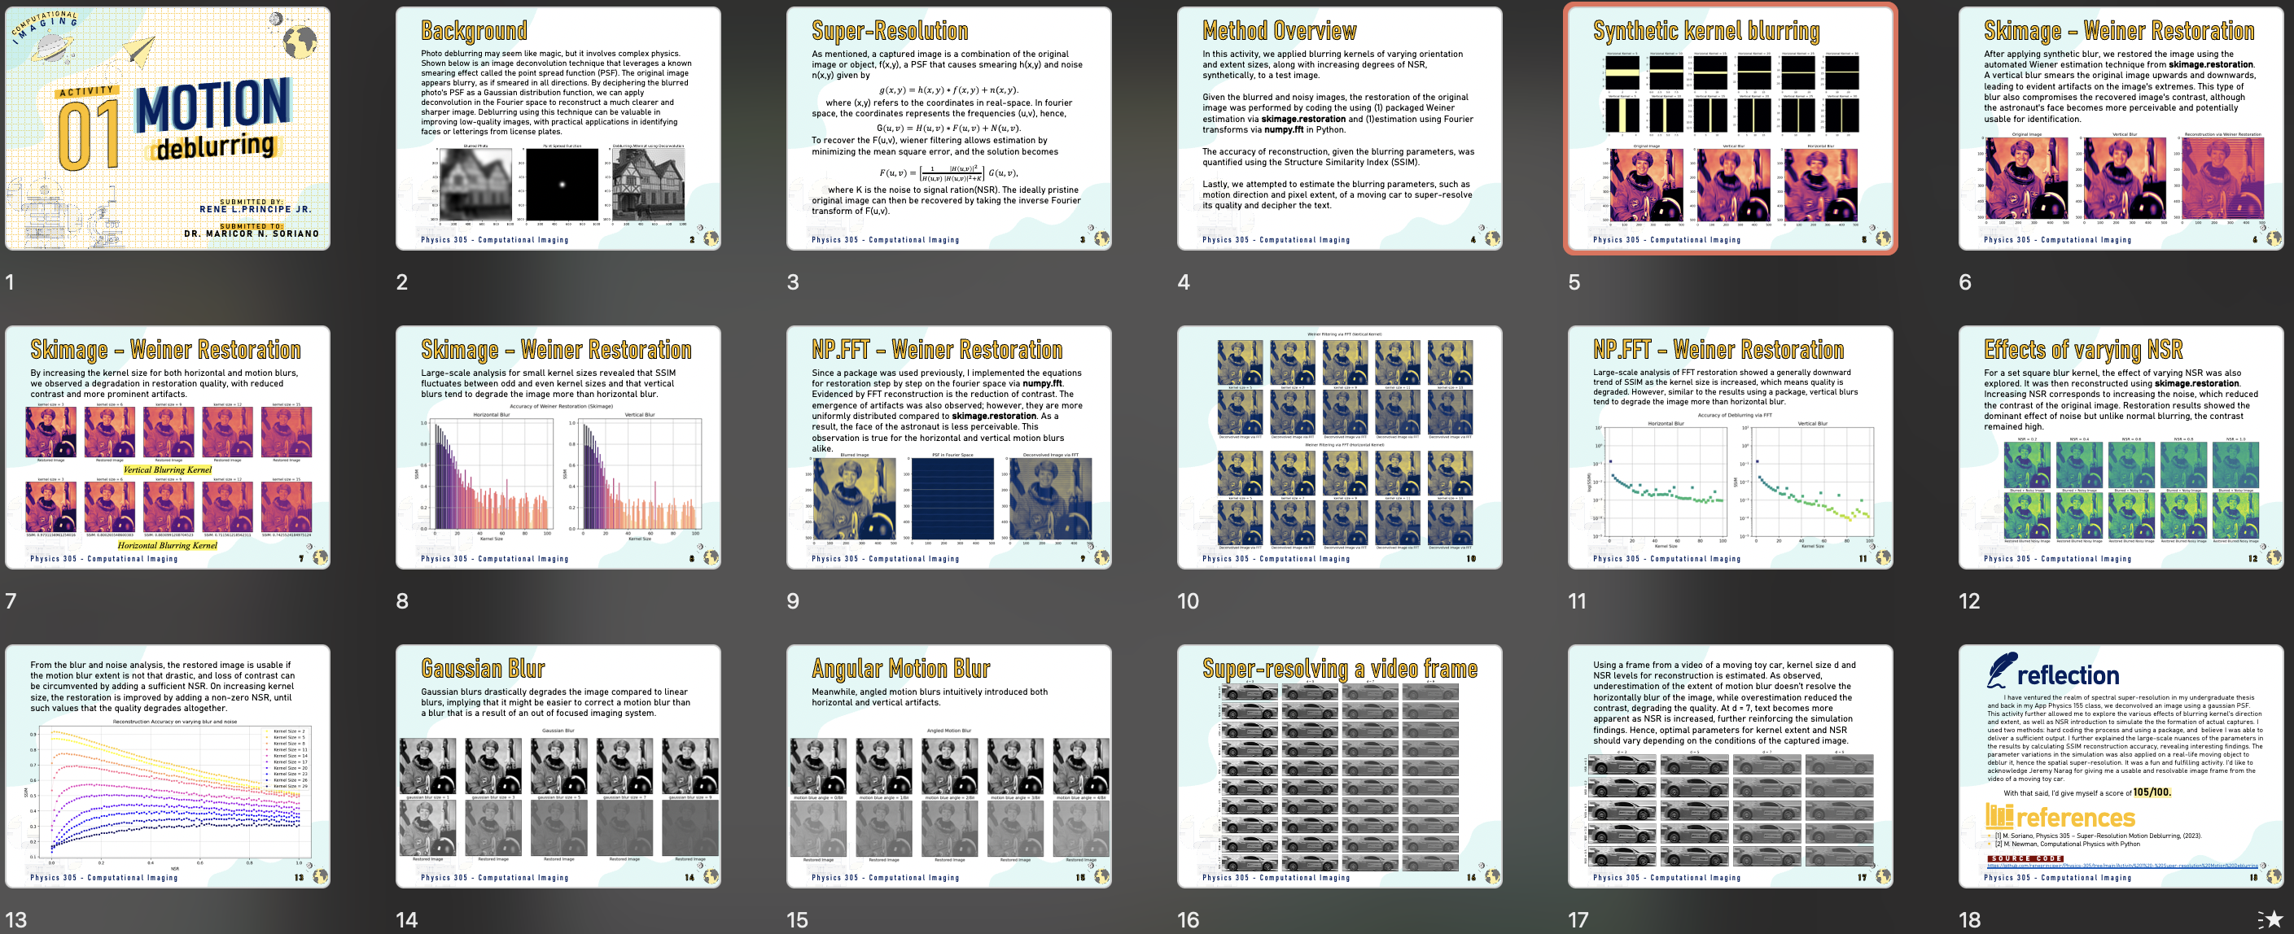

Slide 18
WS1 Outcome: Bioslide
Activity: Create a bioslide communicating research interests, personality, and essential information concisely and visually.
Research Interests:
Articulate your academic focus concisely.
Personality Expression:
Infuse design elements reflecting your personality.
Contact Information:
Provide essential contact details and relevant links.
Academic Background:
Showcase degrees and affiliations briefly.
Optional: Pronouns, Advocacies, Personal Branding
Push your outputs into the VIP Workshop 2024 Github Repo

Slide 19
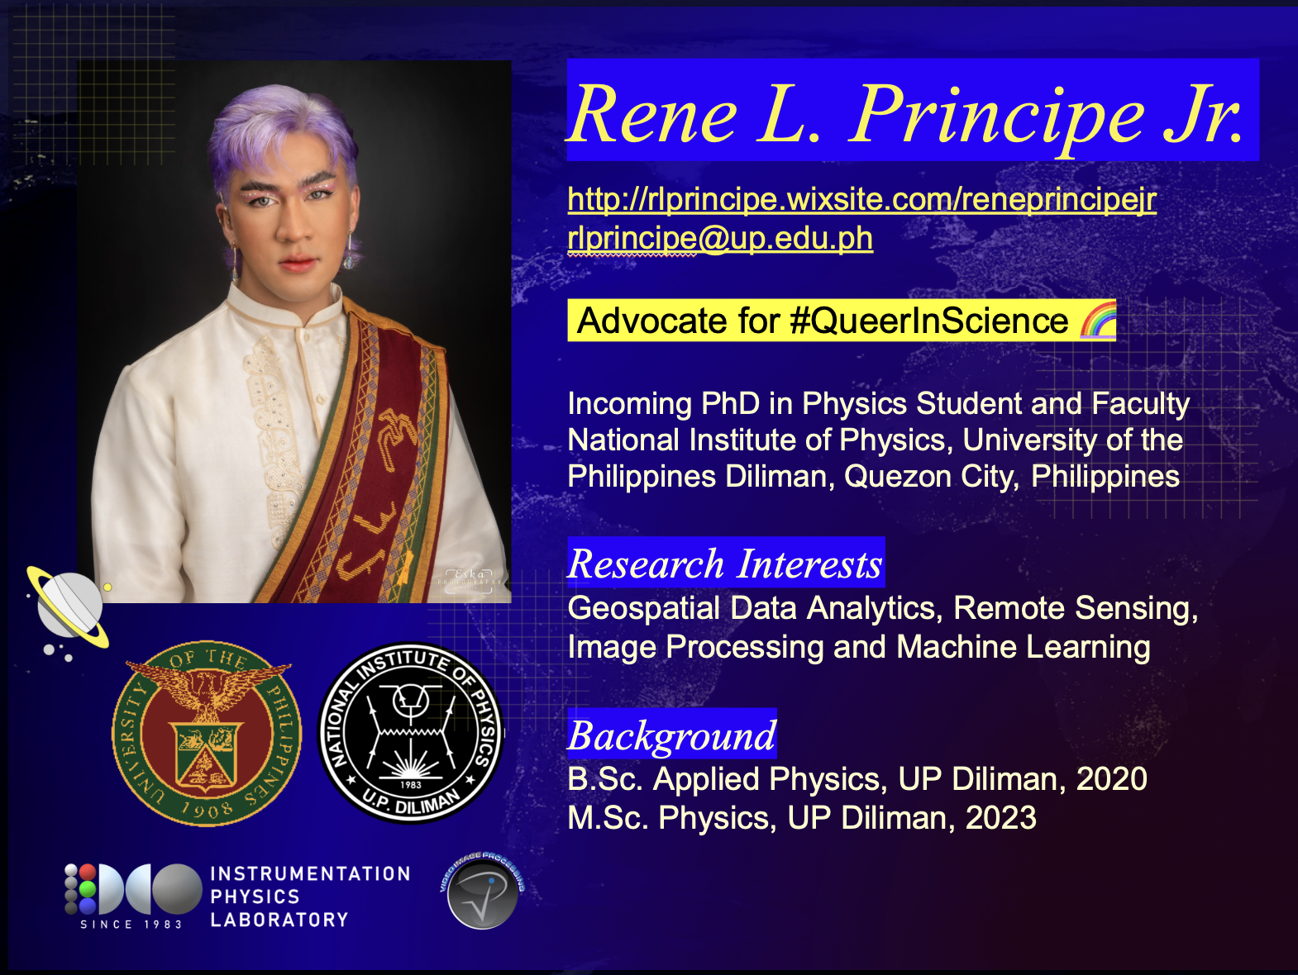
WS1 Outcome: Bioslide

Slide 20







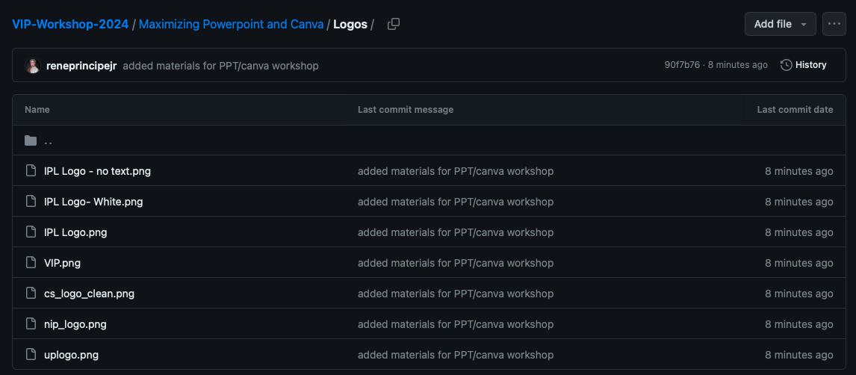
Where to find essential logos?

